Slide 1

Selective Mitigation of Frequency-Domain Backdoor Triggers in Image Classification
Project Phase 2
Supervisor: Dr. Senthilkumar M
Name | Roll Number | Internship details
Varun Mahesh Menon | CB.SC.P2AIE25031 | Wabtec (11 Months) - Bangalore

Slide 2
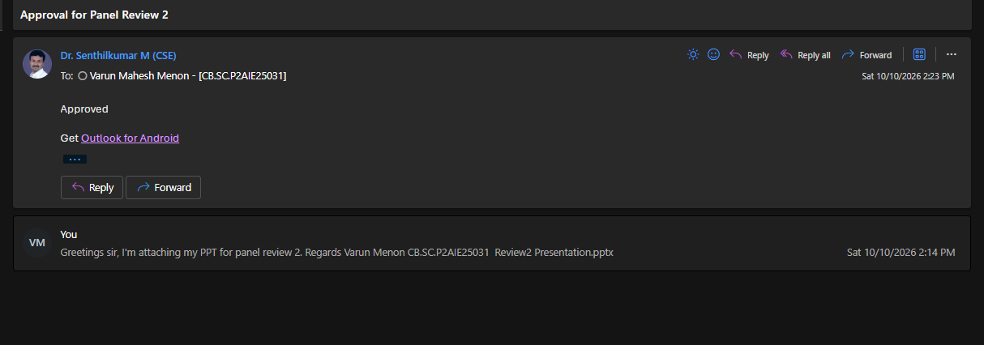
Guide Approval Mail

Slide 3
1. Introduction and Motivation
Why Backdoor Security Matters in Image Classification
Deep-learning classifiers are increasingly used in safety-sensitive applications.
A backdoor can keep normal accuracy on clean images while causing targeted errors when a trigger is present.
A defense should remove trigger dependence without destroying useful image information.
Frequency-domain triggers can be visually subtle and difficult to identify directly in pixel space.
Current frequency-domain defenses suppress all frequency regions — including both trigger frequencies and useful signal frequencies. This is a blunt instrument that degrades legitimate model performance.
“how can we weaken a learned trigger dependency without removing the natural frequency information that the classifier needs?”
clean image -> classifier -> correct class
triggered image -> classifier -> attacker target class

Slide 4
2. Problem Statement
Problem statement:
To develop a selective and adaptive frequency-domain defense that suppresses trigger-related spectral information while maintaining clean-image classification performance.
Objectives
Identify suspicious amplitude changes caused by a trigger.
Learn an adaptive correction map rather than applying one global filter.
Repair the suspicious classifier so it no longer depends on the trigger.
Evaluate the approach across resolutions, trigger strengths, trigger functions and unknown images.

Slide 5
3. Literature Survey and Research Gap
Source | What the paper does | Limitation for our problem | What our project improves
Frequency- domain Pertubation | Retrains the classifier using frequency-perturbed images. | Changes model weights and requires a clean subset plus retraining. | Keeps the classifier frozen and produces a corrected image from one input.
BAM | Learns an input purifier from simulated backdoor behavior. | General image-space purification; spectral support is less explicit. | Uses amplitude, phase, residual and frequency position, with causal support tests.
Semantic-aware | Uses a trusted model to detect suspicious behavior, then performs unlearning. | Needs a trusted comparison model and modifies the suspicious classifier. | Uses no second model at inference and leaves the classifier unchanged.

Slide 6
3.1 Where the First Panel Left the Project
What Phase 1 established | What remained unresolved
Complete poisoning, classifier, generator and repair pipeline | Generator received clean and triggered spectral information
CIFAR-100, Tiny ImageNet and STL-10 | Absolute difference made trigger evidence directly visible
32x32, 64x64 and 96x96 resolutions | Images and triggers were relatively controlled
Strength, function and FIBA-style experiments | Unknown trigger and noise behaviour remained unclear

Slide 7
3.2 Questions Raised After the First Panel
Panel questions | Answer
What if the clean image is unavailable? | The new generator needs only the incoming trigger image. It does not need the original clean version while correcting it.
Is absolute subtraction doing the work? | During training it sees many examples and learns which frequency patterns repeatedly lead to the attack. For a new image, it predicts only the spectral changes that appear suspicious.
Can it handle complex texture images? | Tested on 224x224 DTD with 47 texture classes.
What happens if the attacker changes the frequency location? | We hid two active trigger positions from generator training. On those positions, attack success fell from 99.40% to 7.20% on average.
Does the generator remove the trigger, or does it simply remove any noise? | It did not blindly erase all frequencies. Selective correction worked much better than broad filtering, while strong unrelated noise revealed a clear failure boundary.

Slide 8
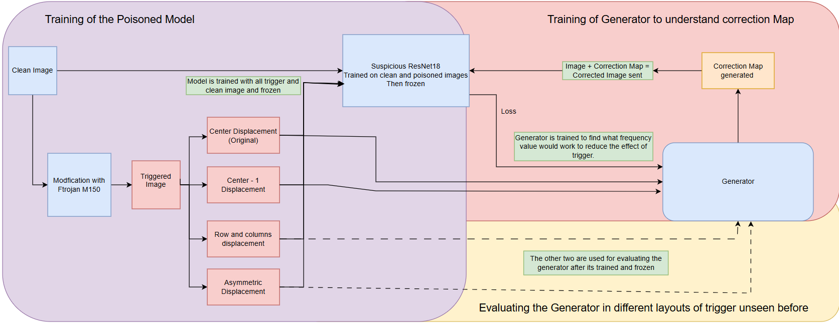
4. Proposed Methodology

Slide 9
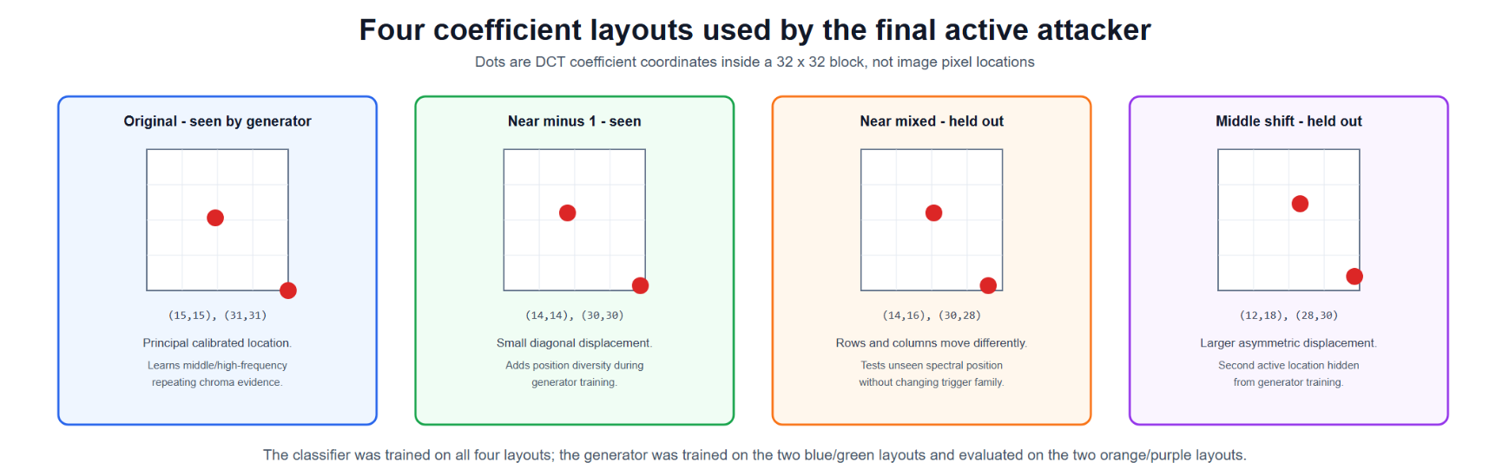
4. Proposed Methodology

Slide 10
4. Proposed Methodology
Start with a clean "striped" image.
Add Trigger Layout
  The suspicious ResNet18 now predicts "banded“.
  Give only the triggered image to the generator.
  The generator examines its frequency representation.
  It predicts:
    Which frequency regions should be changed?
    Should their amplitude increase or decrease?
    How large should the change be?
Reconstruct the corrected image.
Give the corrected image to the frozen ResNet18.
Compare the result with the known original label "striped".
If ResNet18 still predicts "banded", update the generator.
If it predicts "striped" while the image remains visually similar, reward that generator behaviour.

Slide 11
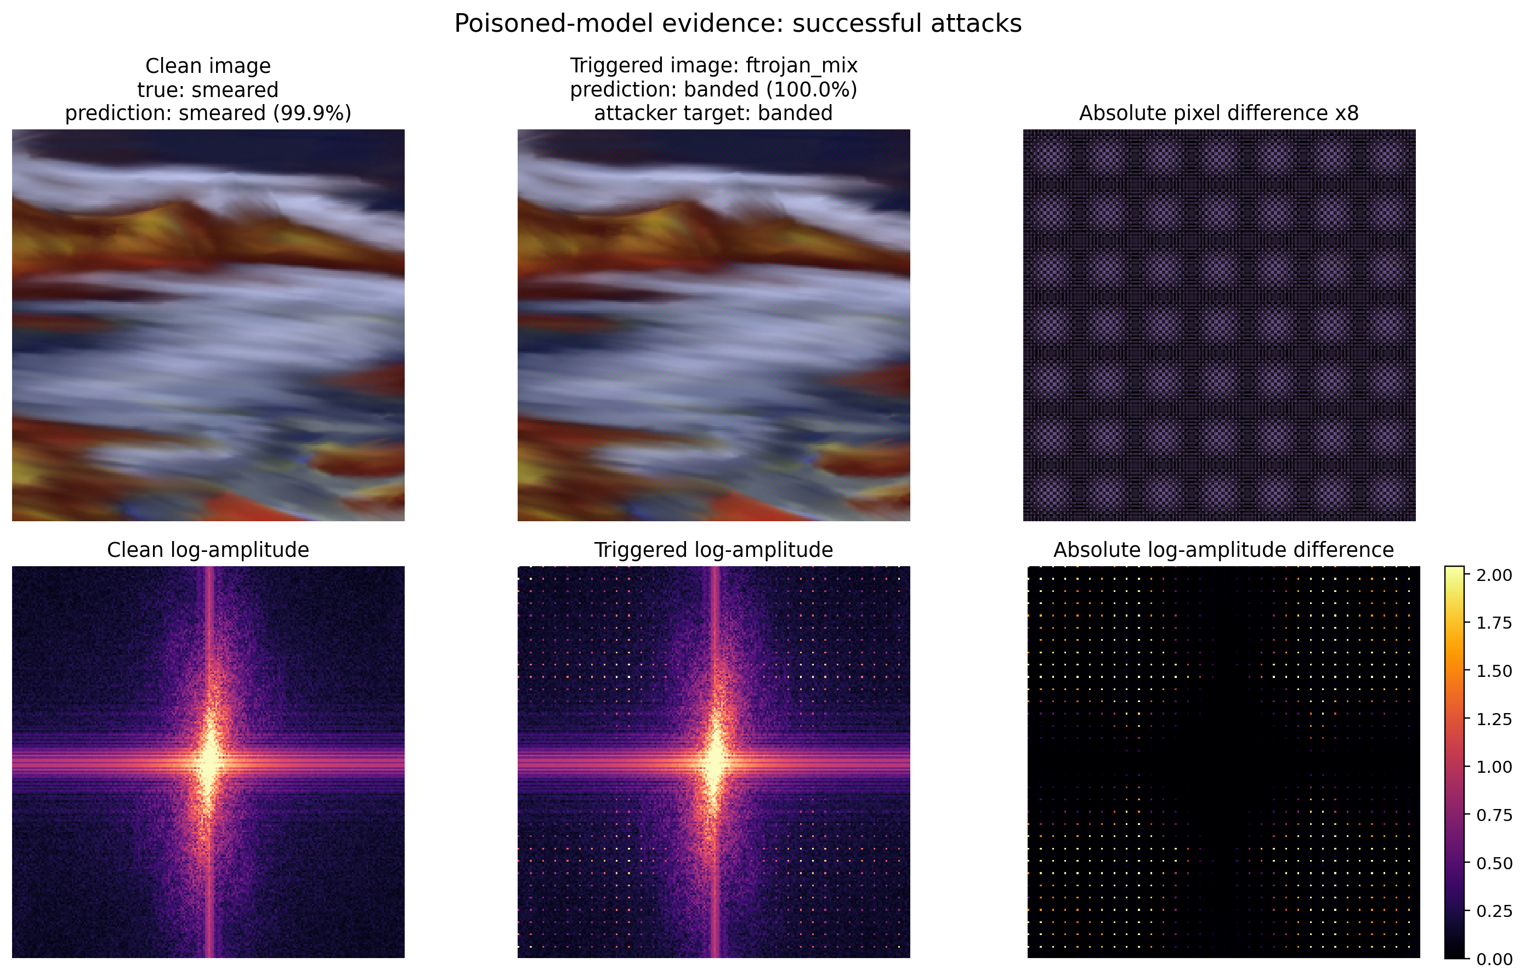
4. Proposed Methodology

Slide 12
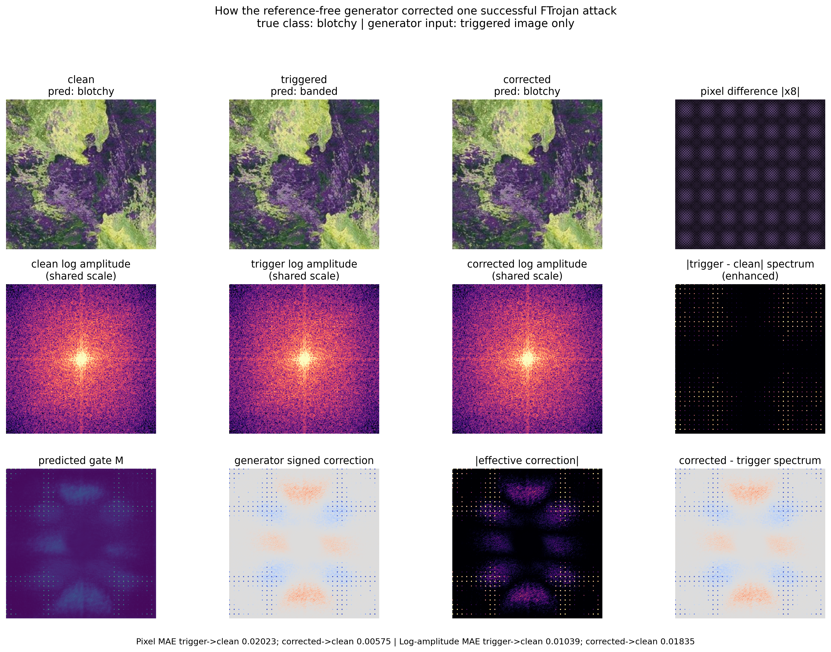

Slide 13
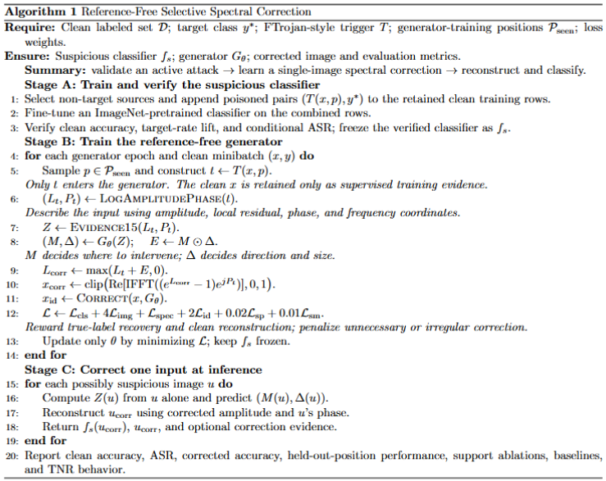
4. Proposed Methodology

Slide 14
5. Datasets
Property | Value
Texture classes | 47
Images per class | 120
Total source images | 5,640
Official split-1 training | 1,880
Official split-1 validation | 1,880
Locked test | 1,880
Evaluation resolution | 224x224 RGB
Classifier | ImageNet-pretrained ResNet18
Attacker target | Class 0, banded

Slide 15
6. Implementation Progress and Discussion
Candidate | Evidence | Decision
Direct Fourier-band trigger | Triggered target 13.53%; clean target 9.89% | Rejected due to weak ASR
Haar-LH wavelet | ASR 9.67%; clean target 9.51%; lift 0.16 pp | Rejected due to weak ASR
Early FTrojan M50 | Poison-row target 95.21%; validation approximately 15.9% | Rejected due to weak validation phase
FTrojan M100 | ASR 86.63%; clean target 5.60%; lift 81.03 pp | Accepted
FTrojan M150, four positions | Every position approximately 99.4% to 99.7% ASR | Accepted and Final benchmark

Slide 16
6. Implementation Progress and Discussion
Component | Final advanced configuration
Dataset | DTD, official split 1
Input | 224x224 RGB crop
Classifier | ImageNet-pretrained ResNet18, 47 classes
Attack | FTrojan-style block-DCT, four positions, magnitude 150
Target | banded
Generator | 771,238-parameter encoder-decoder
Generator input | Single-image 15-channel FFT evidence
Generator output | Gate plus bounded signed log-amplitude proposal
Phase policy | Preserve incoming phase
Evaluation | 1,840 non-target validation sources per position

Slide 17
7. Standard Algorithms and Evaluation Metrics
Core algorithms
Evaluation metrics
FFT / IFFT
- Decompose image into amplitude and phase.
ResNet-18
- ImageNet-pretrained 47-class texture classifier.
Correction generator
- Predicts a gate and signed log-amplitude change.
Optimization
- Classification, image, spectral, identity, sparsity and smoothness losses.
Clean accuracy
- Normal classification utility.
Attack Success Rate (ASR)
- Fraction forced into the attacker's target class.
True-label recovery
- Correct classification after correction.
Target-rate lift and conditional ASR
- Verify that the trigger caused new failures.
Pixel L1 and TNR
- Measure image change and trigger/noise stress.

Slide 18
8. Tools and Implementation Expertise
Training and models
Analysis and evidence
Python and PyTorch
- Dataset pipelines, poisoning, model training and generator optimization.
Kaggle GPU
- NVIDIA T4 sessions for attack and generator experiments.
Pretrained learning
- ImageNet ResNet-18 adapted to 47 DTD classes.
Signal processing
- FFT/IFFT, log amplitude, phase preservation and block-DCT trigger injection.
Reproducibility
- Saved checkpoints, JSON summaries, manifests and fixed evaluation splits.
Visualization
- Correction maps, spectral panels, ablation charts and a CPU demonstration notebook.

Slide 19
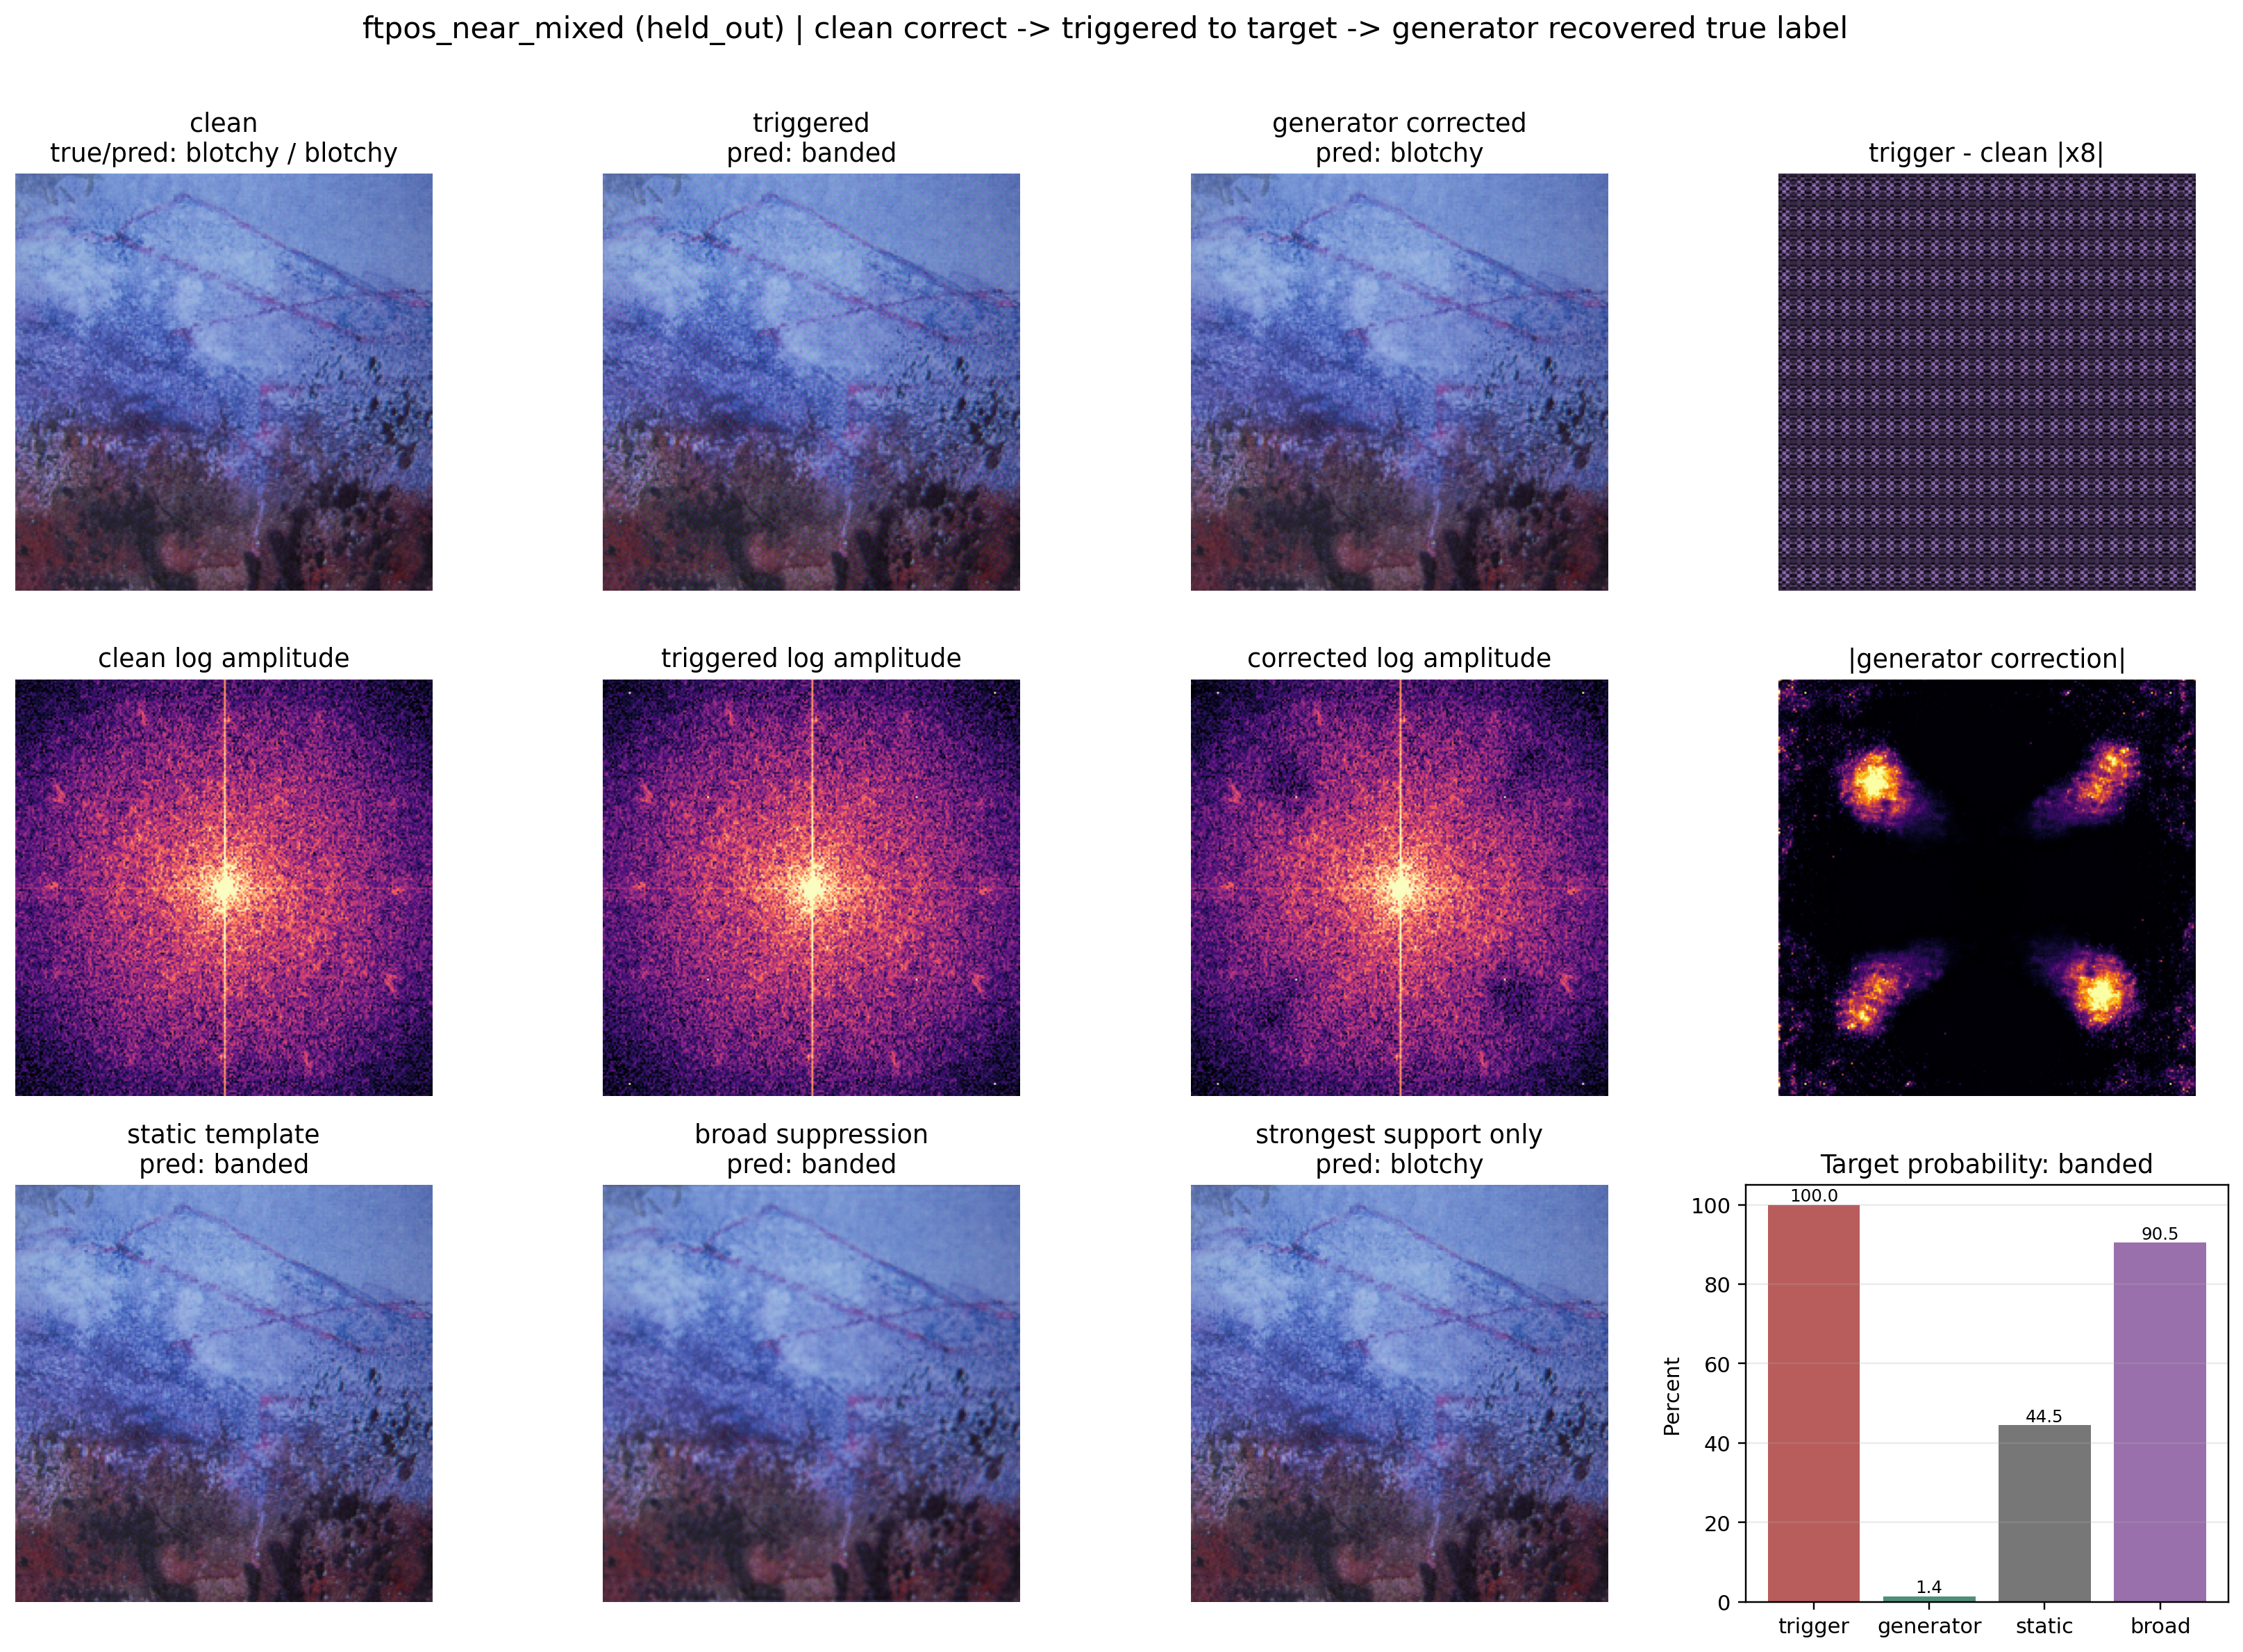
9. Results

Slide 20
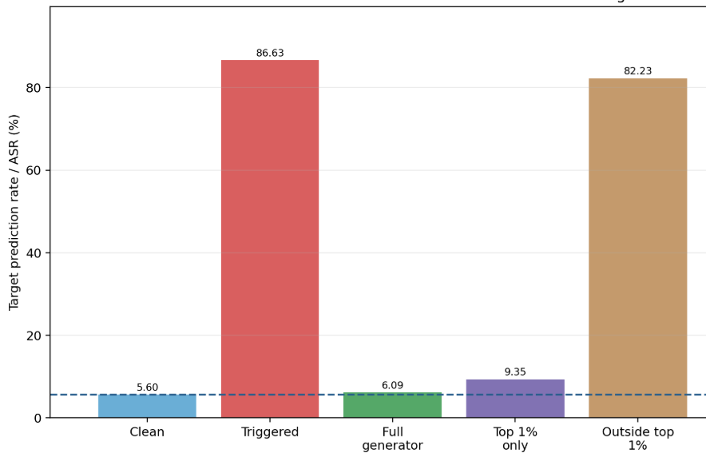
9. Results

Slide 21
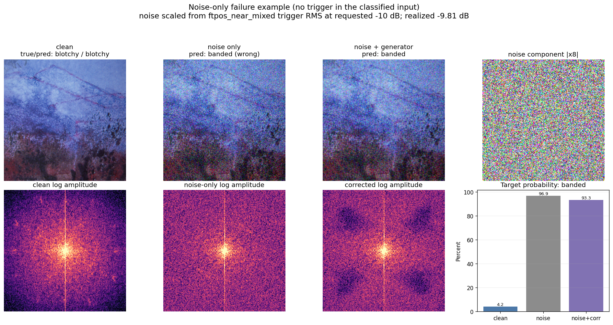
9. Results - Trigger Versus Noise

Slide 22
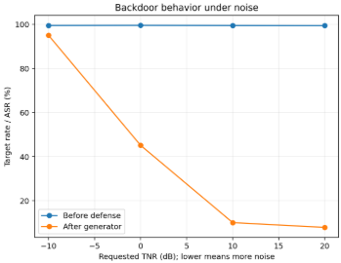
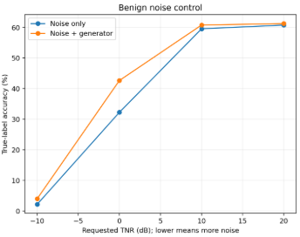
9. Results - Trigger Versus Noise
Condition | Corrected ASR | Corrected accuracy
Trigger only | 7.64% | 60.29%
+20 dB, trigger much stronger than noise | 7.85% | 60.19%
+10 dB, trigger stronger than noise | 10.04% | 58.93%
0 dB, equal RMS power | 45.11% | 35.52%
-10 dB, noise stronger than trigger | 95.05% | 3.48%

Slide 23
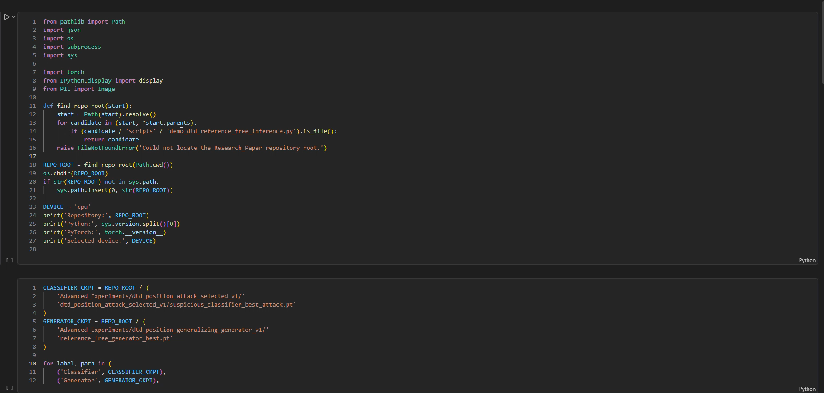
10. Demonstration

Slide 24
11. SDG Mapping
Potential application relevance: SDG 3
Good Health and Well-being
Medical imaging is a future application area where model backdoors could create serious risks. The current presentation does not claim completed medical validation; SDG 3 is presented as an application motivation and future direction.
Primary mapping: SDG 9
Industry, Innovation and Infrastructure
The project develops a security-oriented machine-learning method intended to make AI systems more reliable and trustworthy, particularly when models may be trained using externally supplied or compromised data.

Slide 25
12. Project Plan for Semester 3
Period | Activity | Status | Expected output
Completed | Attack calibration, generator training, held-out tests, baselines and TNR study | Done | Frozen results, checkpoints and evidence figures
Oct-Nov 2026 | Organize literature comparison and write IEEE manuscript sections | In progress | Complete first paper draft
Nov-Dec 2026 | Guide review, revisions, formatting and final submission preparation | Planned | Submission-ready paper and dissertation material

Slide 26
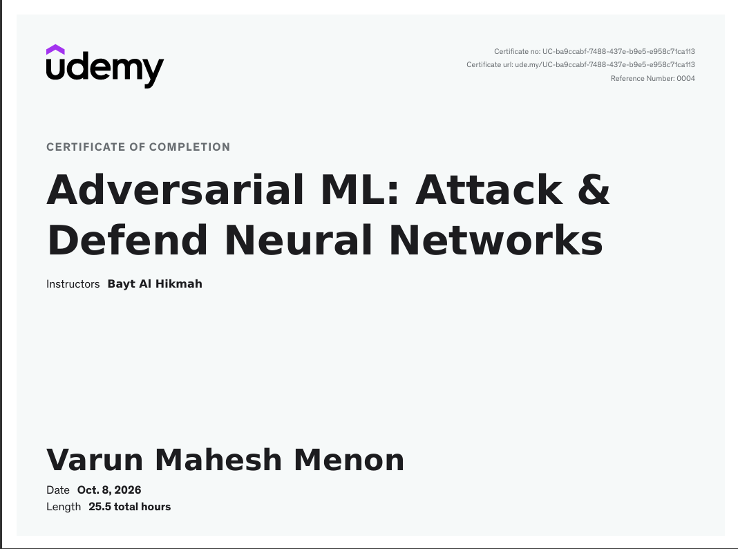
13. Domain Expertise Course

Slide 27
13. Domain Expertise Course
Module 5 had a direct relation to my research because it discussed poisoning and backdoor attacks. I applied this method to Describable Textures Dataset with an ImageNet-pretrained ResNet-18.
The chosen non-target images were attacked by an FTrojan-type of frequency trigger, which is related to the target class banded. The initial models were dismissed because high success rate in the poisoned training samples could not be generalized to images outside the training set.
I conducted multiple calibration attacks sweeps and chose a validated attack model with acceptable clean performance. I evaluated it based on clean accuracy, success rate of the triggered attacks, rate of clean target, attack success lift and conditional attack success in order to make sure that natural errors will not be counted as attacks.
After that, the suspicious classifier was frozen, and used for training a reference-free generator. In the process of evaluation, the generator receives only one possibly triggered image without its clean version.
It evaluates the amplitude, phase, local spectral residual and frequency coordinates, and makes a selective prediction about amplitude correction of the image before reconstruction and classification.
I trained the generator with two trigger position layouts and tested it on held-out layouts. These tests provided evidence that correction was linked to a small, meaningful spectral region rather than simple clean-trigger subtraction or removal of the entire spectrum. MITRE ATLAS also helped place this work within broader data-compromise and supply-chain threats.

Slide 28
14. Technical Enrichment Activities
Deliverable | Description | Expected deliverables
Submission-ready Research Paper Draft | Prepare a complete research paper in IEEE, Elsevier, Springer, ACM, or any other appropriate conference/journal format based on the project work. | Complete manuscript; Figures and tables; References; Similarity report
Open-source Technical Repository | Maintain a professional GitHub repository containing reusable project resources. | Source code; Well-structured project organization; README; Installation guide; Documentation; Regular commits with version history
Working demonstration | Develop a working end-to-end prototype that demonstrates the core functionality of the project and validates key performance outcomes. | Demonstrate a working model of the project - hardware or deployed software. Also, submit a run-based demo: short video + instructions + the commands/script that regenerates the metrics and sample outputs (with model/config versions).

Slide 29
15. Conclusion
Advanced method: One-image, reference-free selective log-amplitude correction with phase-preserving reconstruction.
Main result: Four-position mean ASR reduced from 99.48% to 7.64%, with 60.29% corrected accuracy versus approximately 61.44% clean accuracy.
Evidence quality: Causal support tests, static/broad baselines, held-out active positions, benign corruptions, and TNR stress testing.
Boundary: Demonstrated on DTD and within one calibrated attack family; cross-family, adaptive, locked-test, and multi-seed evidence remain Phase 3.

Slide 30
16. References
Gu, Tianyu, Brendan Dolan-Gavitt, and Siddharth Garg. "Badnets: Identifying vulnerabilities in the machine learning model supply chain." arXiv preprint arXiv:1708.06733 (2017).
Zhang, Ping, Hongyuan Yue, and Chau Yuen. "Backdoor Defense Strategy for Image Classification Tasks based on Frequency Domain Perturbation." IEEE Internet of Things Journal (2026).
Feng, Yu, Benteng Ma, Jing Zhang, Shanshan Zhao, Yong Xia, and Dacheng Tao. "Fiba: Frequency-injection based backdoor attack in medical image analysis." In 2022 IEEE/CVF Conference on Computer Vision and Pattern Recognition (CVPR), pp. 20844-20853. IEEE, 2022.
Lu, Run, Peipeng Yu, Zhitao Huang, Zhihua Xia, and Xiaoyan Jiang. "BAM: Backdoor defense based on adversarial mitigation." Pattern Recognition (2025): 112662.
Fu, Kang, and Jianhua Dai. "Semantic-aware framework for backdoor detection in ai models." International Journal on Semantic Web and Information Systems (IJSWIS) 21, no. 1 (2025): 1-21.

